Slide 1
Cloud Data Journey
Shivani Anand (Sr. Principal Solution Architect)
Prajakta Yerpude ( Sr. Software Engineer)
The opinions expressed in this presentation are those of the presenters, in their individual capacity, and not necessarily those of Discover

Slide 2
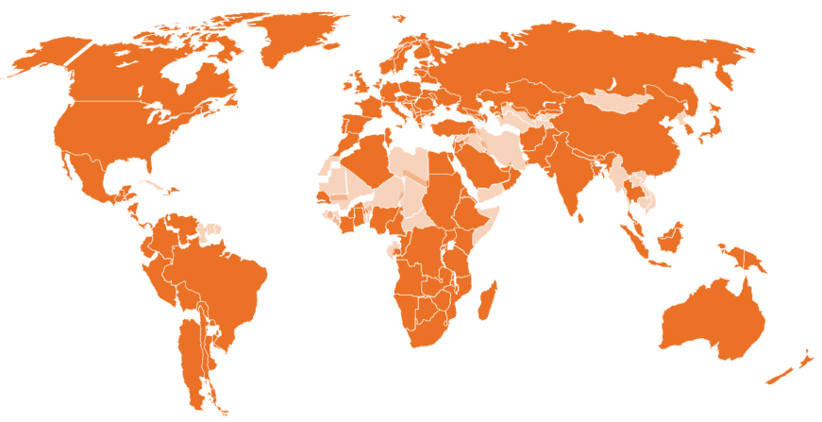



Discover Financial Services
Digital Banking
$71Bn in card receivables
$143Bn card sales volume
Leading cash rewards program $63Bn direct-to-consumer deposits
Cashback Checking and Debit
$10Bn private student loans
$7Bn personal loans
$2Bn home equity loans
Vision: To be the leading digital bank and payments partner
Mission: To help people spend smarter, manage debt better and save more so they achieve a brighter financial future.
VALUES
Doing the right thing
Innovation
Simplicity
Collaboration
Openness
Volunteerism
Enthusiasm
Respect
200+ Countries / Territories 50MM+ Merchant Locations ~2.2MM ATMs
$212Bn volume ~2.2MM ATMs in 140 countries /territories $24Bn volume Accepted in 200+ countries 50MM+ merchant locations $32MM volume 20+ network alliances
Focus 2021
1
2
3
4
Commitment to Diversity, Equity and Inclusion.
Accelerate Growth & Drive Efficiencies
Reduce Charge-offs
Grow Payments Business
Strengthen Foundation
©2021 Discover Financial Services - Confidential and Proprietary - Do not copy or distribute
Notes:
2

Slide 3
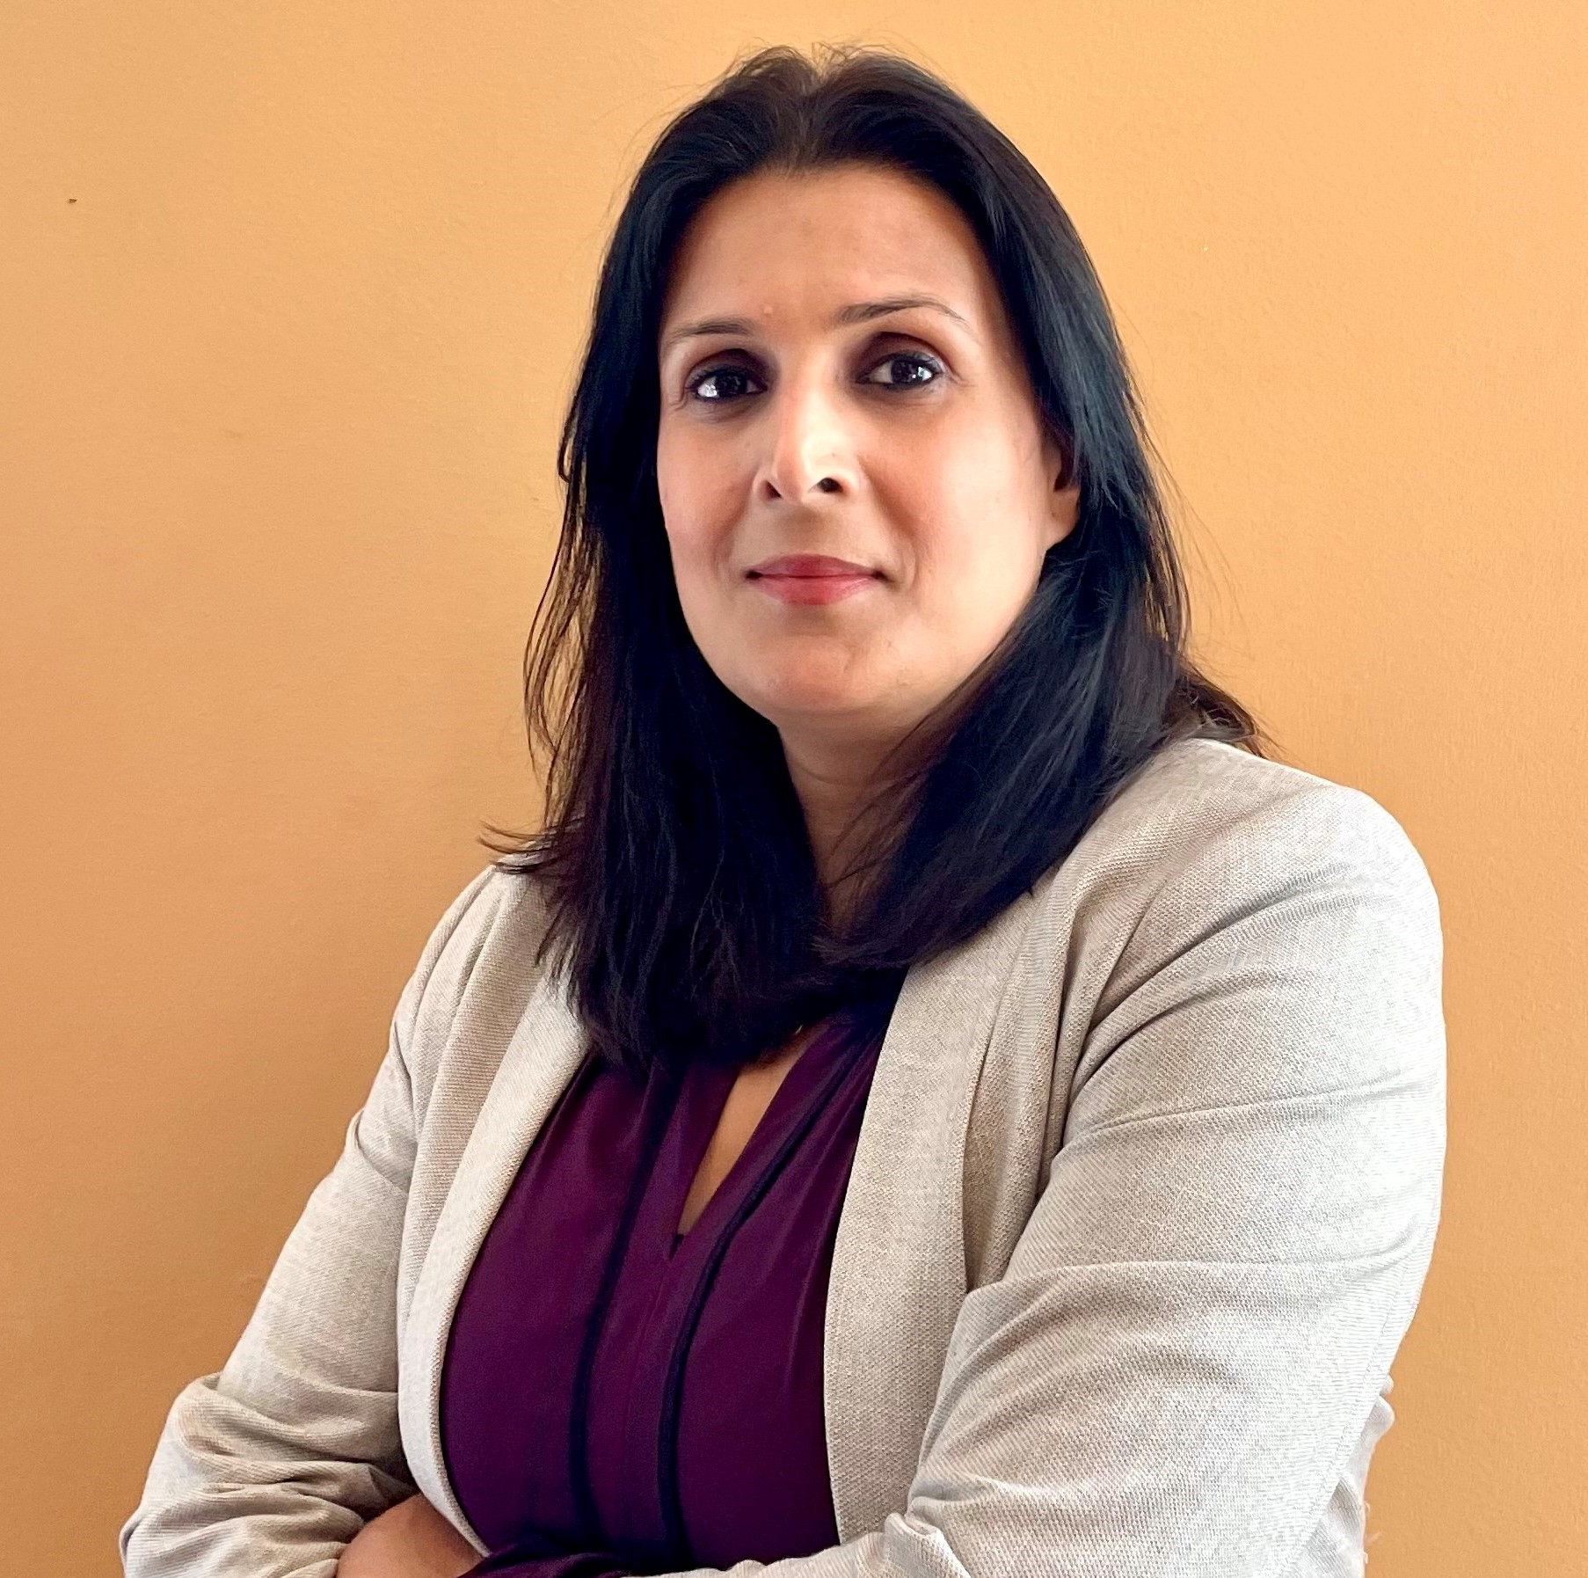
Speaker 1: Shivani Anand
Senior Principal Solution Architect at Discover, focused around providing technology and data driven solutions for Data and Analytics (DNA) organization
Energetic forward-thinking leader with significant experience in serving organizations with Data Warehousing and Business Intelligence space including Fortune 500 companies.
At Discover, she is actively involved in business-critical Data Science and Analytics initiatives which requires solutions around cloud technologies.
Innovate | Collaborate | Motivate
©2021 Discover Financial Services - Confidential and Proprietary - Do not copy or distribute

Slide 4

Speaker 2 : Prajakta
Senior Software Engineer at Discover, focused on Cloud data products team Data and Analytics (DNA) organization
Extensively working in cloud technology for over five years especially implementing variety of data ingestion pipelines helping drive faster analytics
At Discover, she works hands on with data engineering and Dev ops teams doing CICD, automation, data integration solutions, migration of legacy databases
©2021 Discover Financial Services - Confidential and Proprietary - Do not copy or distribute

Slide 5
Agenda
Learning to fly from Ground to Cloud
Challenges
Four C’s
Cloud technologies
Collaboration
Changing Mindsets
Continuous Learning
Accomplishments
Lesson Learnt
Next Steps
©2021 Discover Financial Services - Confidential and Proprietary - Do not copy or distribute

Slide 6
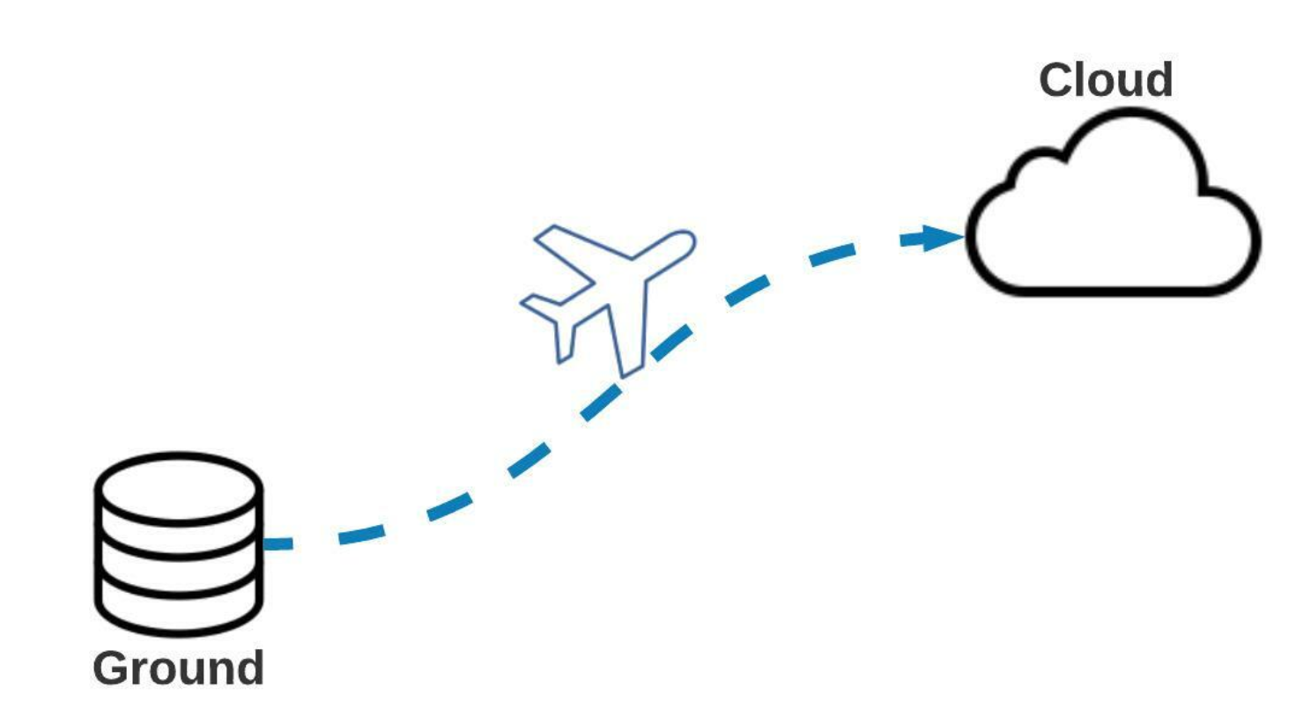
Flight to Cloud
Learning to fly from Ground to Cloud
Faster-to-market information leading to stay ahead in competitive digital business landscape.
Standard pipelines that are easy to develop, maintain, and support
Higher quality data assets that enable true self serviced to drive business value
©2021 Discover Financial Services - Confidential and Proprietary - Do not copy or distribute

Slide 7

We have all been there….
Challenges
Large Legacy Stack
High Storage Costs
Capacity and Scalability Constraints
Maintaining Data Centers and Resources
Large Deployments with a Downtime
Dependencies on multiple teams
©2021 Discover Financial Services - Confidential and Proprietary - Do not copy or distribute

Slide 8




Four C’s
What it takes to be successful in the Cloud Data Journey?
……. 4C’s
Cloud Technologies
Collaboration
Changing Mindsets
Continuous Learning
©2021 Discover Financial Services - Confidential and Proprietary - Do not copy or distribute

Slide 9



Cloud Technologies
Four C’s
Flexibility: The flexibility of using Platform (PaaS), Infrastructure(IaaS) and Software(SaaS) on fly leading to faster product development and deployment
Speed: Distributed Platform Architecture with Autoscaling
Performance: Multiple Network Load-Balancers With Low Latency, High Availability And Uptime Guarantee
Storage: Seamless And Infinite Capacity
Cost: Pay As You Use
©2021 Discover Financial Services - Confidential and Proprietary - Do not copy or distribute

Slide 10

Collaboration
Four C’s
True Partnership!!!
Business Centric
Data Centric
©2021 Discover Financial Services - Confidential and Proprietary - Do not copy or distribute

Slide 11

Changing Mindsets
Four C’s
Think like a start up!!!
Let Engineers fly!!!
©2021 Discover Financial Services - Confidential and Proprietary - Do not copy or distribute

Slide 12

Continuous Learning
Four C’s
Learning & Innovation go hand in hand!
©2021 Discover Financial Services - Confidential and Proprietary - Do not copy or distribute

Slide 13
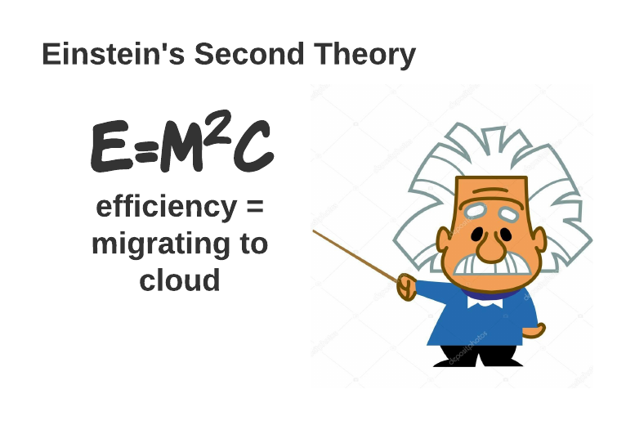
Where we are...
Accomplishments
Cloud Data Pipelines
Data ingestion and ELT in Cloud
Dedicated engineering teams
Applying Advanced Analytics & Data Science on curated data
Being a true Enterprise Data Centric Organization
©2021 Discover Financial Services - Confidential and Proprietary - Do not copy or distribute

Slide 14
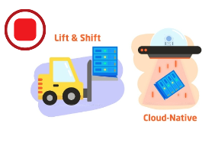


What we learnt during our flight...
Lesson Learnt
It's not a Lift and Shift
Identify all the dependencies between Technology and Business Perspective
Start with simple and critical business use cases
Train your partners on cloud adoption
It's not Set and Forget
©2021 Discover Financial Services - Confidential and Proprietary - Do not copy or distribute

Slide 15

Our Journey continues...
Next Steps
Embracing & Enhancing cloud technologies
Extending collaborations with our business partners
Encouraging teams to change mindset with new way of working
Expanding continuous learning culture
"This is a journey and requires a culture of continuous learning and discontent with the status quo." - Amir Arooni, CIO, Discover
©2021 Discover Financial Services - Confidential and Proprietary - Do not copy or distribute

Slide 16
©2021 Discover Financial Services - Confidential and Proprietary - Do not copy or distribute

